Slide 1
Dipartimento di Ingegneria e Scienze dell’Informazione
Interactive Dashboards for
Measuring Wikipedia Community Health
Bachelor Degree Thesis Presentation
Student: Paolo Aliprandi
Supervisor: Alberto Montresor
Co-supervisor: Cristian Consonni, Marc-Miquel Ribé, David Laniado
20/7/2022

Slide 2
Summary
Context and Motivation
Personal Contribution
Technologies and Architecture
Implementations and Results
Future Steps

Slide 3
Context and Motivation - The Project
The Community Health Metrics project wants to measure, understand, make recommendations
and tools to improve Wikipedia communities health.
The project goal is to bring awareness in the current state of the wikipedia community health.
The first step to tackle a problem is to visualize it. Hence the creation of interactive dashboards.
But what exactly means Wikipedia health?
3 / 20

Slide 4
Context and Motivation - Vital Signs
The Wikipedia health status is an emerging property of the Wikipedia Vital Signs:
Retention
Stability
Balance
They are metrics defined by the Eurecat researchers.
The first three are about Wikipedia active users, the last three are about specific functions.
Each of them will be visualised in the interactive dashboards.
Specialists
Admins
Global
4 / 20

Slide 5
Personal Contribution
I’ve contributed at the project by:
Analyzing over 20 GB of data from Wikipedia database
Mainly, coding and creating Python scripts to visualize and plot Wikipedia Vital Signs data
Adapting and deploying the scripts from a local architecture to a remote server architecture
Studying how to improve the front-end user experience
Coding automated description to enhance the dashboards readability
5 / 20

Slide 6
Technologies and Architecture
WikiCHM Dashboards
Visual dashboards
Frontend
Dash
Web applications
Plotly
Plotly visualisations
Pandas
Data frames
Backend
SQLite3
DB
SQL database
Self-contained DB engine
6 / 20

Slide 7
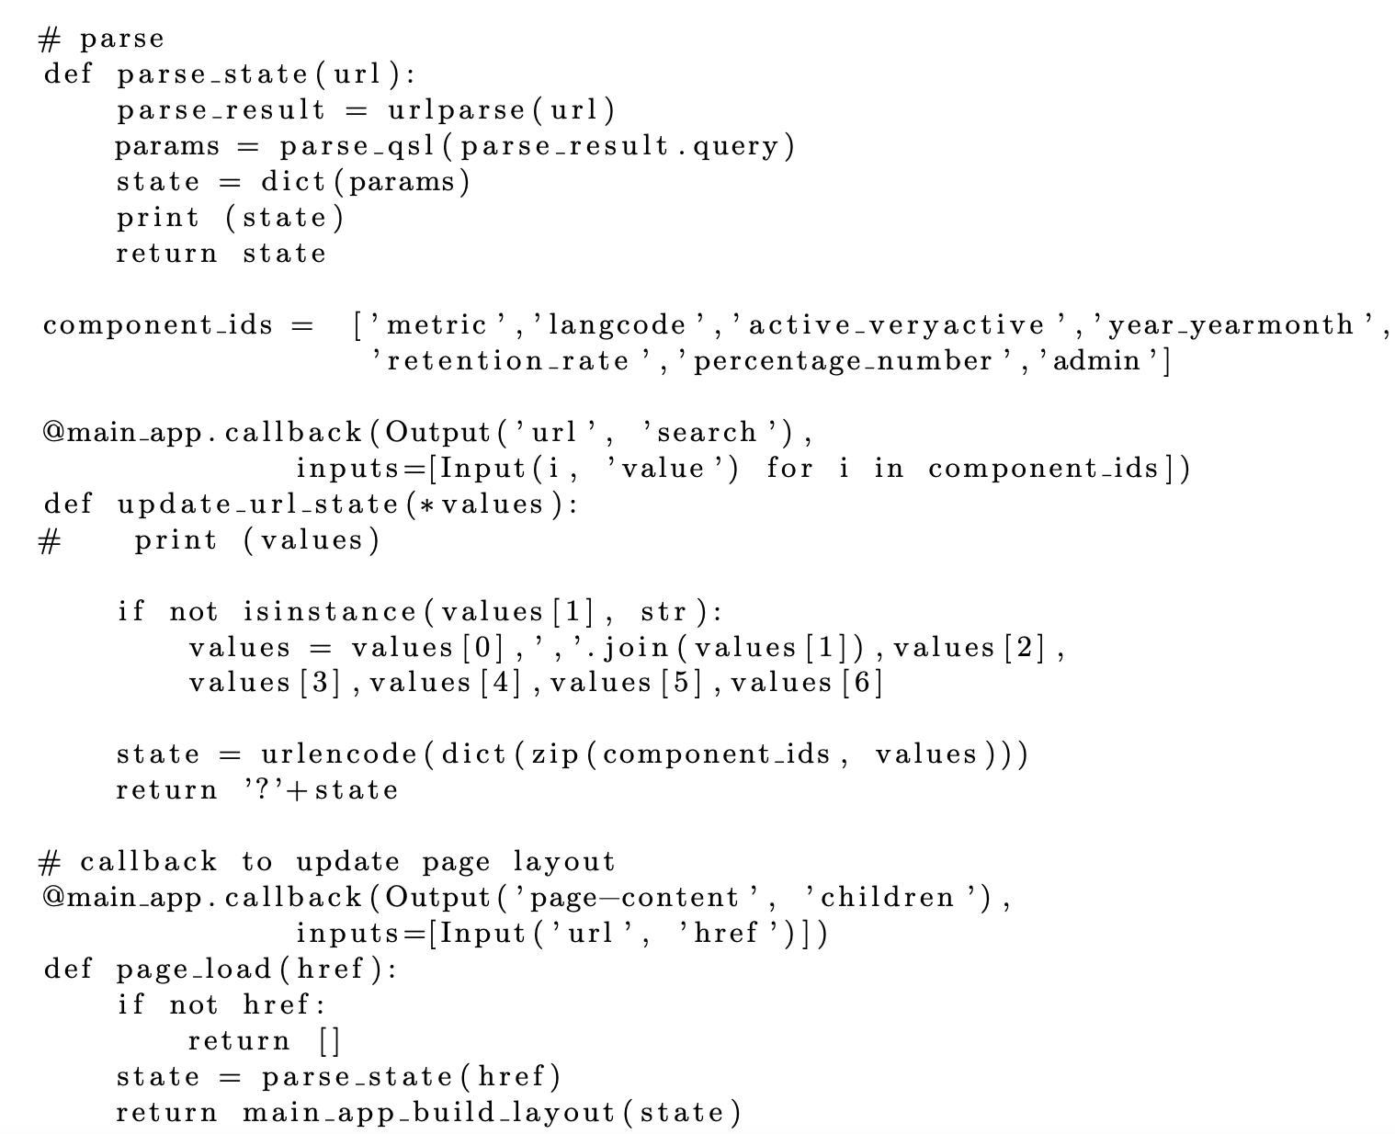
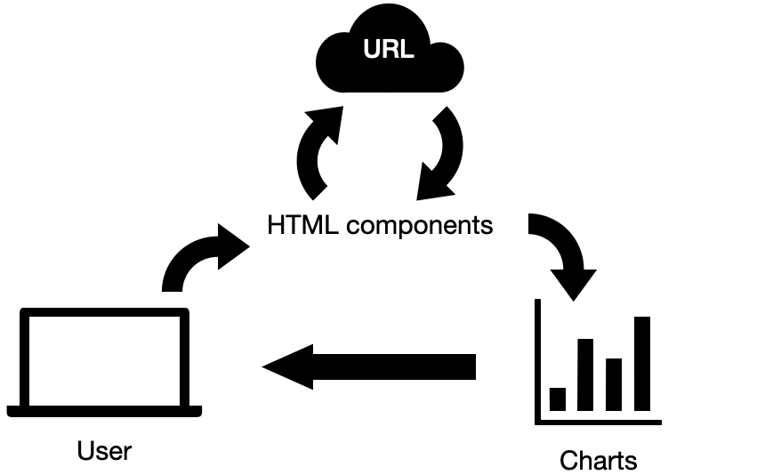
Implementation and Results - Dynamic Layout
URL
Callbacks loop for URL-parameters
7 / 20

Slide 8
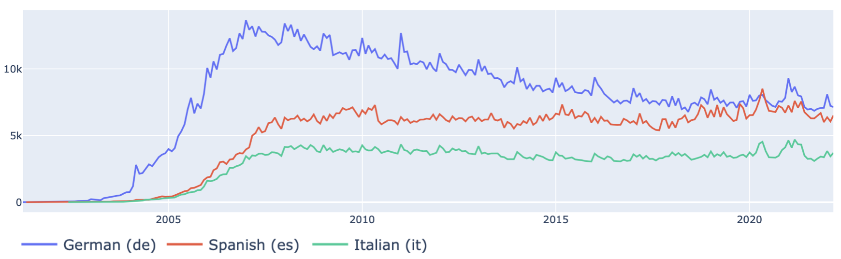
Implementation and Results - Editors
Editors are the active users of Wikipedia. They can be divided in two class:
Active editors, those who edit at least 5 times per month
Very active, those who edit at least 100 times per month.
8 / 20

Slide 9
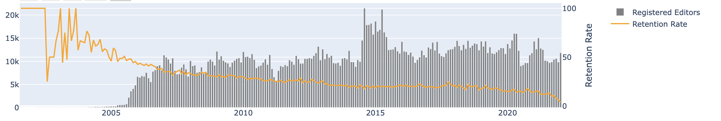

Implementation and Results - Retention
The retention rate of a certain community is calculated as the percentage of new editors that survives 60 days after their first edit.
9 / 20

Slide 10
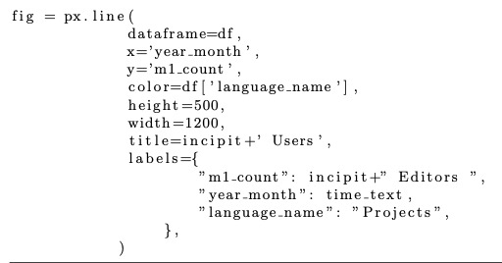
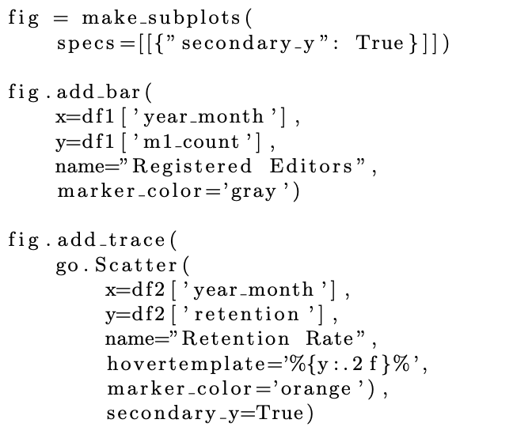
Implementation and Results - PX and GO
Line chart created with Plotly Express
Dual-axis bar chart created with Plotly Graph Objects
10 / 20

Slide 11
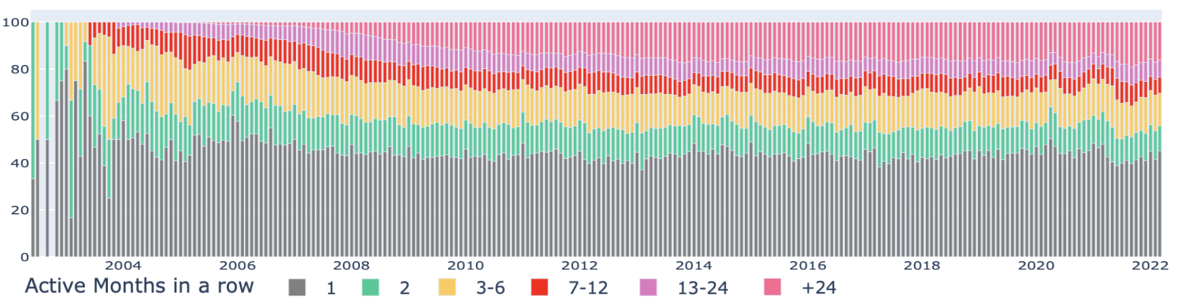
Implementation and Results - Stability
The stability of the community is given by the persistence of active editors as well as by the succession of the various generations of editors over time.
11 / 20

Slide 12
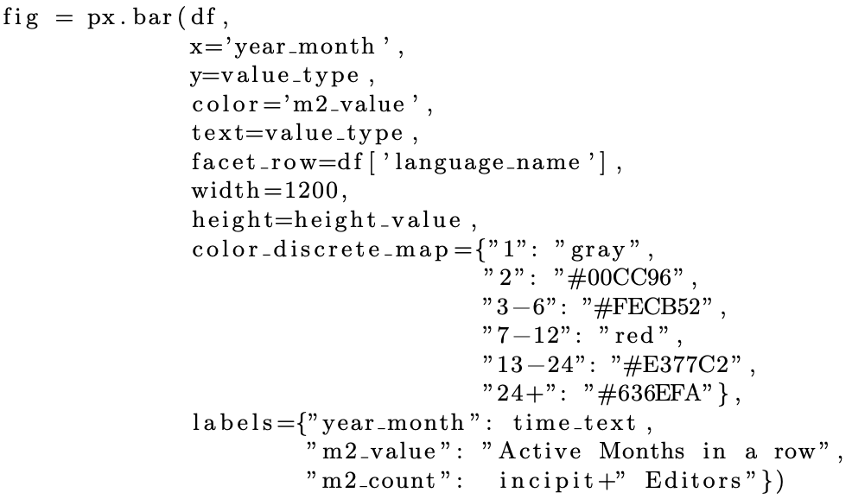
Implementation and Results - Stability
Stability values have been plotted on a stacked bar chart, the most common type of graph.
It allows the visualization of both absolute and percentage values, as well as both type of editors.
Furthermore, to plot multiple stability charts we use the Plotly Express feature for
“faceted graphs”: facet_row[‘df_column’]
Stacked bar chart Python code
12 / 20

Slide 13
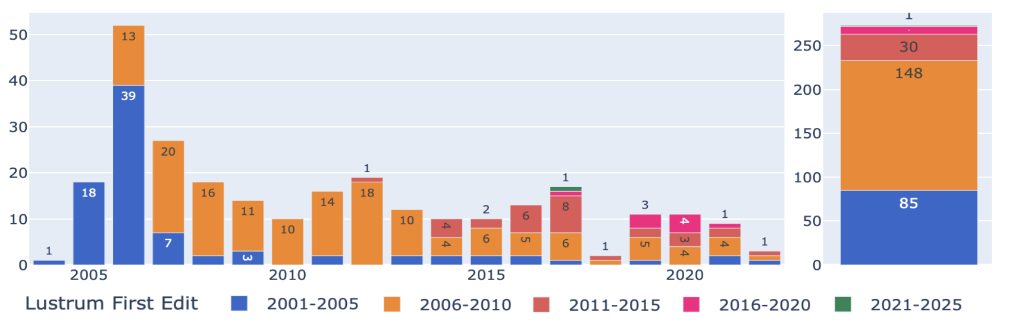
Implementation and Results - Admin Flags
Administrators are wikipedians that have special rights and responsibilities when it comes to acting on content and play a key role in supervising the various communities.
13 / 20

Slide 14
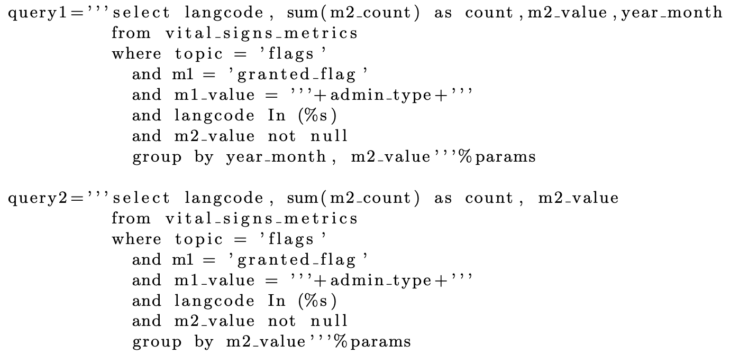
Implementation and Results - Admin Flags
Admins query with GROUP BY year_month. m2_value
Admins query with GROUP BY m2_value
14 / 20

Slide 15
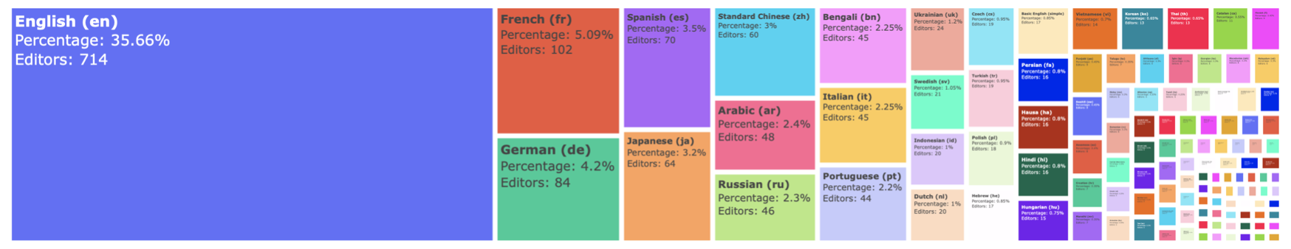
Implementation and Results - Meta-Wiki
The meta-wiki is the global community site used for Wikipedia’s projects coordination.
Every Wikipedia language community should participate, in order to make its voice heard.
15 / 20

Slide 16
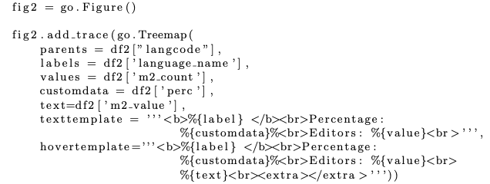
Implementation and Results - Meta-Wiki with GO
Dual-axis bar chart created with Plotly Graph Objects
Treemap chart created with Plotly Graph Objects
16 / 20

Slide 17
Implementation and Results - Highlights
Every dashboard is paired with automated captions that make the graph(s) more understandable.
These are called highlights. They bring more information to the user, along with some formal consideration.
Every highlights works as the other graphs: has some source of data from which to read, and has a prefixed template to be filled with dynamic data.
17 / 20

Slide 18
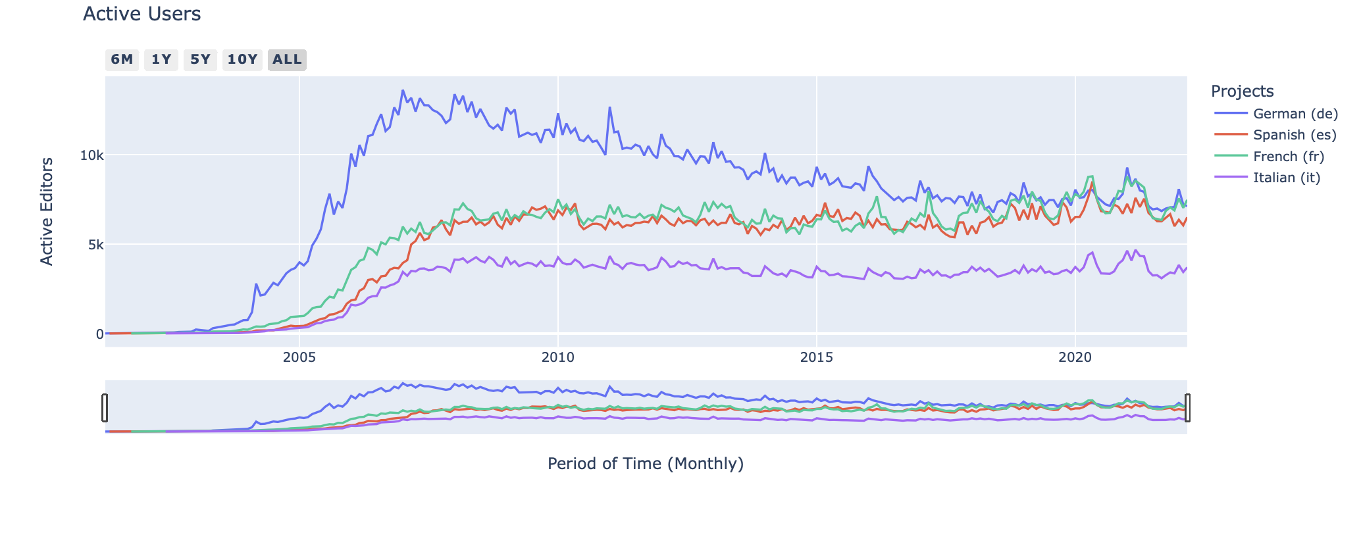
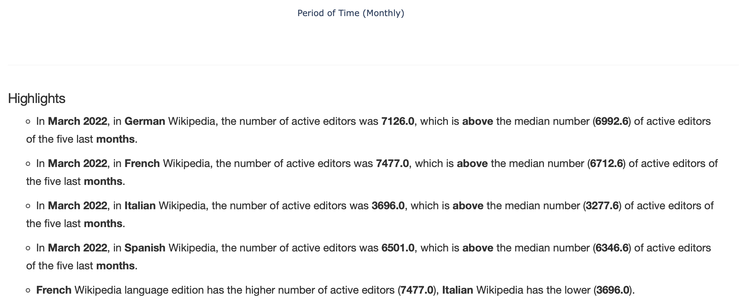
Implementation and Results - Highlights
18 / 20

Slide 19
Future Steps
In the future, the team will carry on the project even further by automating the publishing of the data in the Meta-Wiki
The team will continue to supervise the Wikipedia health status using the dashboards
Eventually, new metrics will be defined or new charts will be implemented
19 / 20

Slide 20
Thanks for the attention!
20 / 20

Slide 22
Technologies and Architecture
Plotly is a graphing library that provides a wide variety of charts for visualising data.
Different data needs different charts for a better understanding of their true meaning.
Though each graph has its particular features, each of them is interactive.
Since plotly allow the graphs to change which data column to show, the user has the possibility to exactly visualize the desired data: from the time period to the value type.

Slide 23
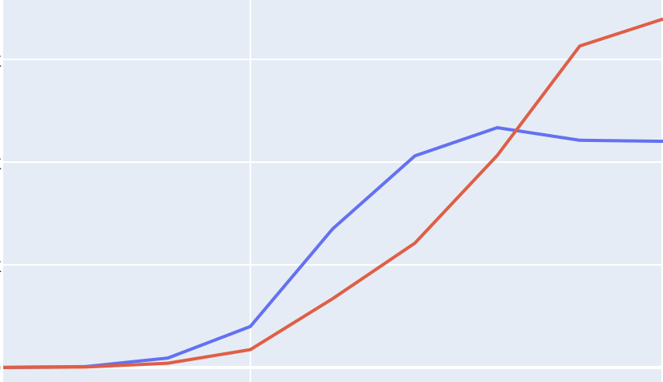
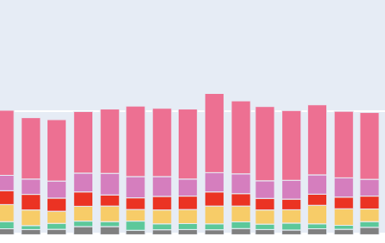
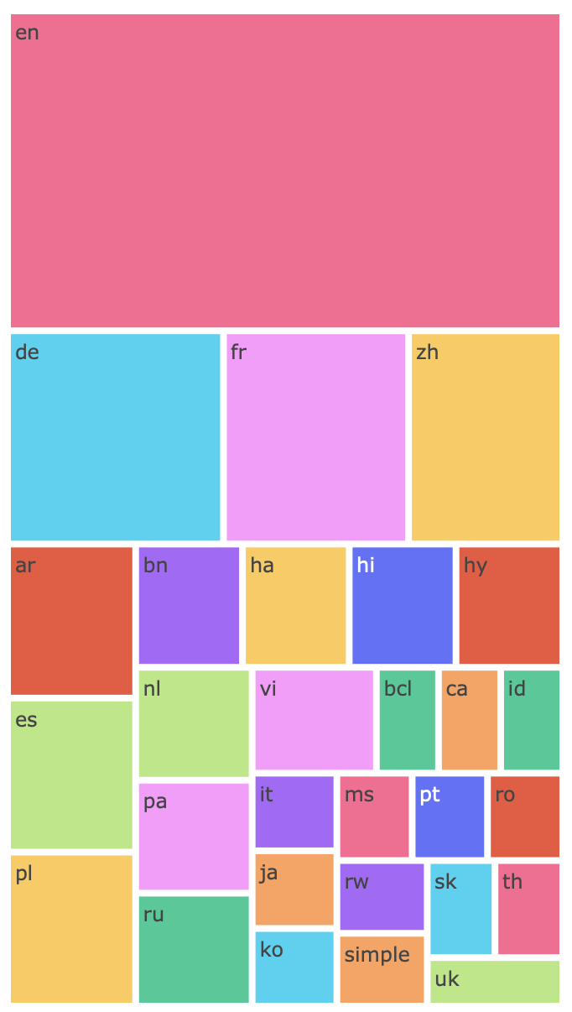
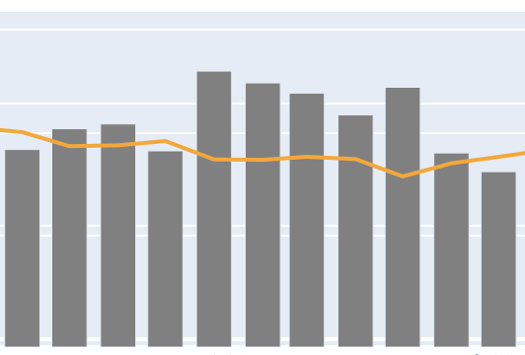
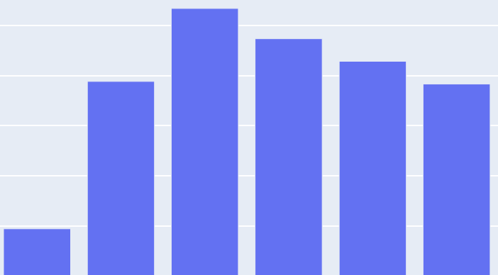
Technologies and Architecture - Plotly

Slide 24
Implementation and Results - Dash
Dash is the web framework on which the plotly apps runs. It is tailored to create visual dashboards in an extremely simple way.
The entire layout is built with Dash, there is no HTML nor CSS in the code.
It allows the definition of asynchronous functions to make the layout dynamic.
These callbacks, let the user interact with the layout in order to change it along with the Plotly charts.

Slide 25
Implementation and Results - Pandas
Pandas is the mediator between frontend code and backend code.
It can encapsulate big data in objects, the dataframes, that are easy and convenient to manipulate, and are also compatible with Plotly charts.
With Pandas dataframe, we capture the results of queries to the database. But we could also read other data files like .csv file or .xlsx file.

Slide 26
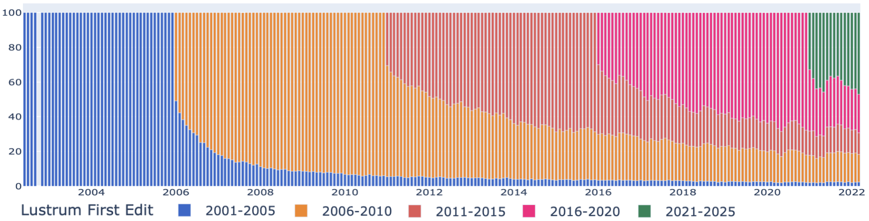
Implementation and Results - Balance
Community balance measures the ability to maintain an equal proportion of old and new contributors.

Slide 27
Implementation and Results - Specialists
The technical and community coordination functions performed by the wikipedians are essential to ensure the sustainability of the technical tasks.
First we have technical editors. The majority of the them belongs to the 2006-2010 generation, regardless of them being active or very active.
Then we talk about coordinators. There are fewer and fewer new coordinators, especially among very active editors.

Slide 28
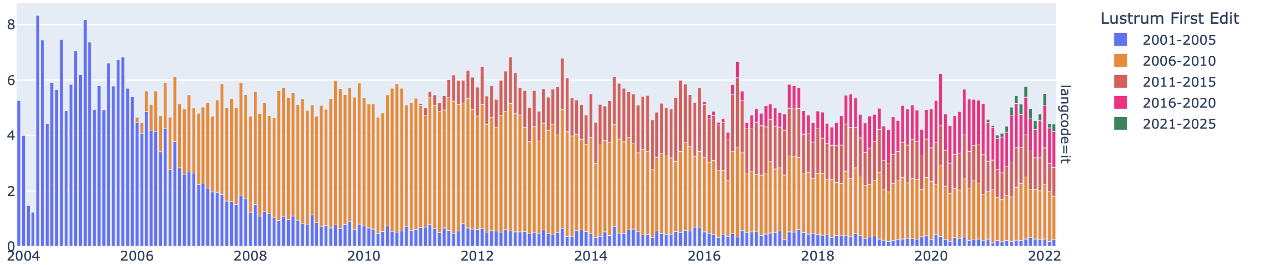
Implementation and Results - Active technical editors
First we have technical editors. The majority of the them belongs to the 2006-2010 generation, regardless of them being active or very active.

Slide 29
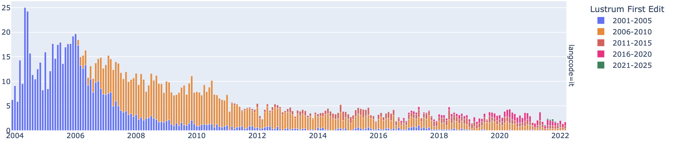
Implementation and Results - Very active coordinators
Then we talk about coordinators. There are fewer and fewer new coordinators, especially among very active editors.

Slide 30
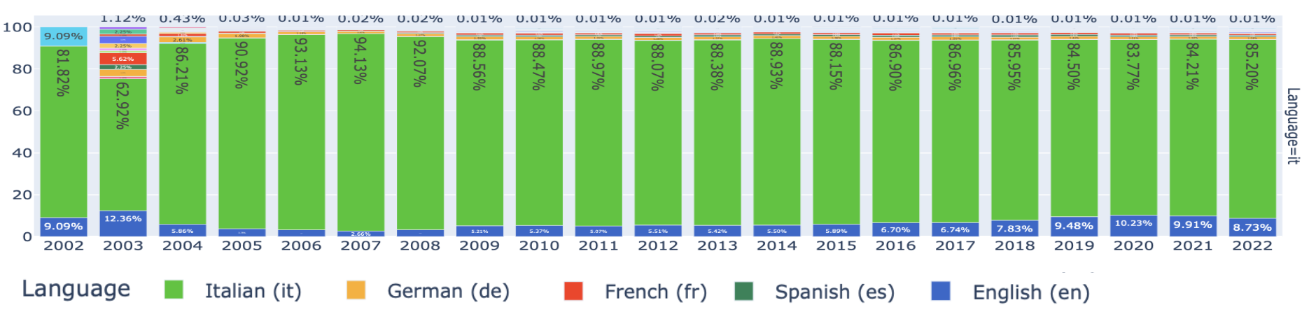
Implementation and Results - Meta-Wiki
Wikipedia is a community project. The participation of each local community in the global community is essential for making their voices heard and learning from others.

